Slide 1







CRIME ANALYSIS
Group 1

Slide 2









OUR TEAM
Satya Akhil Govvala
Sameera Sajeevan
Aby Solly
Mac Johnson

Slide 3





PROBLEM STATEMENT
Crime rates in the United States are a matter of significant concern, and understanding patterns and predicting potential crime victims can aid law enforcement agencies in proactive measures.
This project aims to analyze a comprehensive crime dataset to identify trends and implement a machine learning model for predicting possible crime victims and estimating their likely age. By leveraging advanced analytics, the objective is to contribute to crime prevention strategies and enhance public safety.

Slide 4
Dataset Information
The dataset utilized for this project was sourced from https://catalog.data.gov/dataset/crime-data-from-2020-to-present, comprising a substantial 800,000 rows and encompassing 28 columns.
This rich dataset furnishes in-depth insights, with a particular emphasis on the nature of assaults, the age and gender of victims, and the temporal aspects of the assaults—factors that constitute the focal points of our analysis.

Slide 5


Methodology
In this project, we leverage Python scripts for conducting Exploratory Data Analysis (EDA), utilizing its robust capabilities to discern overarching patterns and streamline the data cleaning process.
Furthermore, we employ Tableau, a powerful data visualization tool, to create dynamic charts and dashboards that transcend the limitations of static representations.
Tableau's intuitive interface and rich visualization options enable us to present complex data relationships in an accessible manner, fostering a deeper understanding of key insights.

Slide 6




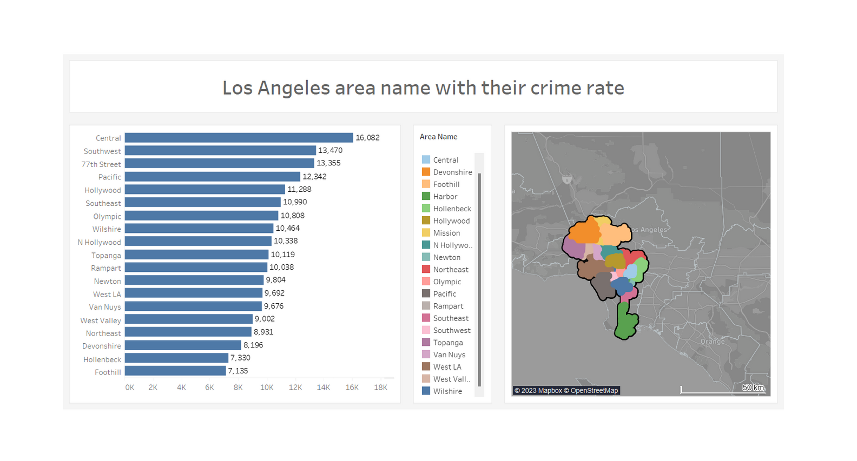

Dashboard

Slide 7
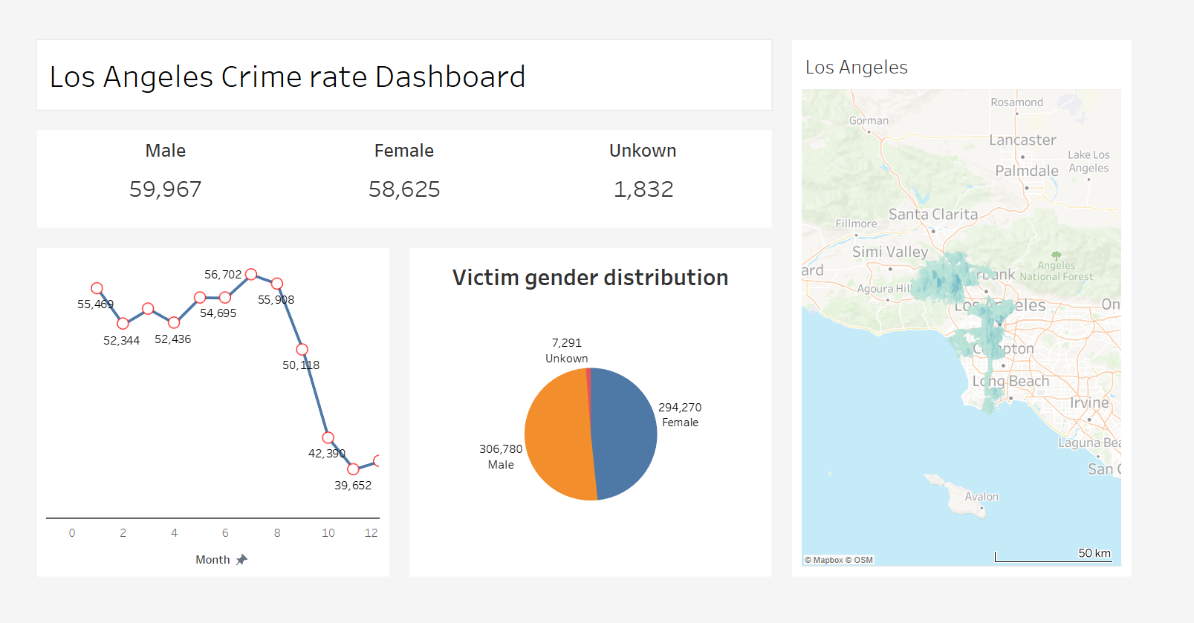
Dashboard

Slide 8
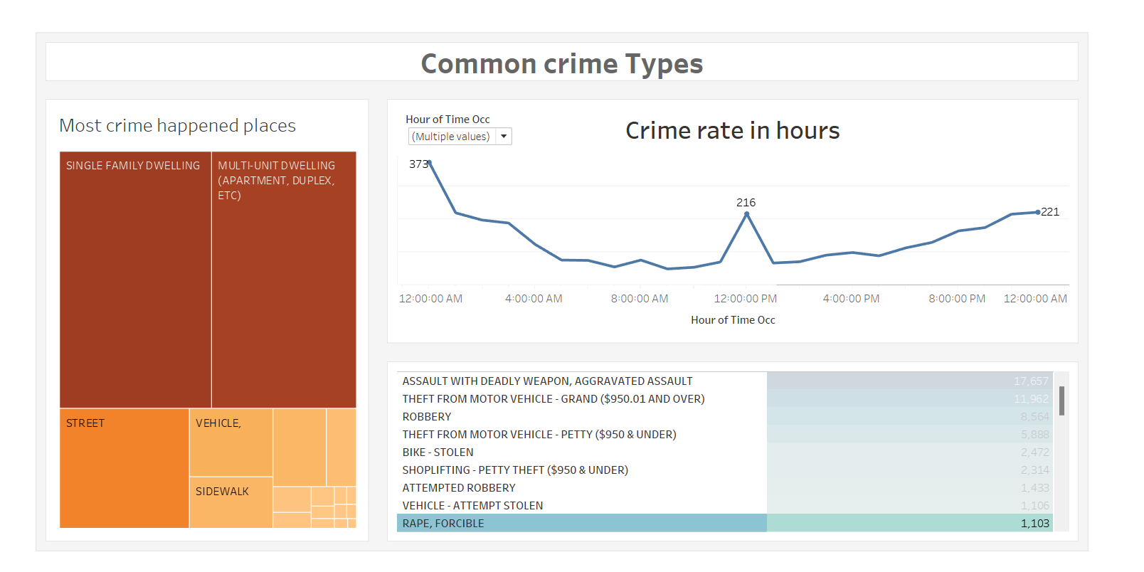
Dashboard

Slide 9




Key Insights
We Can see that Central area is the most affected region with 16,082 crimes over the period and places like Southwest and 77th street also has considerable number of crimes, and the least affected areas are Hollenbeck and Foothill.
If we look at the gender perspective crime rate has been identical to both genders.
Crime rate has been drastically decreased from August till December; we can assume an inclement weather a reason for this considering the geographical factor.
Most of the crimes have happened at apartments – buildings and single - family houses.
There has been gradual increase in crimes during the dusk time, this infers that crime has happened when there is low human visibility.
Theft and assault with weapon are the most crimes that has happened which strengthens the previous point where there is low human visibility.

Slide 10


Challenges/Recommendation
There was spaces in geo locations which was resulting in a bad dashboard we had find a way to delete spaces to present the accurate data
We have null values in victims age and gender, but it is accounting to only 0.5% of the whole data so we have deleted those values.

Slide 11
Future Work
Building upon our initial analysis, we have gained valuable insights into the diverse array of crimes and their interconnections with various influencing factors, including gender, weapon usage, and geographical location.
Armed with this understanding, we are poised to explore and implement various machine learning models tailored to align with our overarching objectives.

Slide 12






THANK YOU

